Slide 1
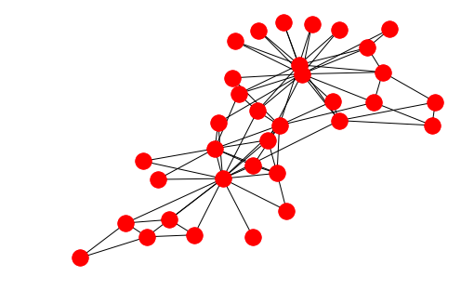
DMSN Tutorial 1: Networks and Random Graphs
Naomi Arnold
https://narnolddd.github.io/

Slide 2
In this tutorial:
Recap on concepts and metrics covered in the lecture
Get to grips with the Erdos-Renyi random graph model
See some of the key similarities and differences between random graphs and real networks

Slide 3
A (very) brief history of network science
1736
Availability of rich datasets
+
Computing power
If you could draw one edge per second and didn’t take breaks, it would take 12,600 years to draw the Facebook graph
1933

Slide 4
Network Science is Interdisciplinary
Social sciences: made first use of ‘sociograms’ as networks, and drive a lot of the motivation for network science
Mathematics/Physics: development of graph theory, models for dynamics on/of networks (often using theory from particle physics!)
Computer Science: developing and implementing algorithms for networks, working with scalability challenges of big data
Field specific applications: epidemiologists studying disease prevention/vaccination, Internet network operators, social network

Slide 5



(Undirected) Graph
A graph is a tuple (V,E) of a set V of vertices and E of edges
Vertex (node) set: {Laurissa, Ben, Naomi, Mathieu}
Edge (link) set:
{ (Laurissa, Naomi),
(Laurissa, Mathieu),
(Naomi, Ben)}
Here, order doesn’t matter as graph is undirected

Slide 6
Directed Graph
Vertex (node) set: {Laurissa, Ben, Naomi, Mathieu}
Edge (link) set:
{ (Laurissa, Naomi),
(Naomi, Laurissa)
(Mathieu, Laurissa),
(Naomi, Ben)}
Here, order does matter as graph is directed

Slide 7
How do we measure graphs?
How do we compare them?

Slide 8
Neighbourhood and Degree
The neighbourhood N(v) of a vertex v is the set of vertices adjacent to V
e.g. N(Naomi) = {Laurissa, Ben}
The degree k(v) of a vertex v is the size of the neighbourhood: |N(v)|
e.g. k(Naomi) =2

Slide 9
Degree Sequence/Average Degree
The degree sequence of a graph is the list of the vertex degrees for that graph (in decreasing order)
e.g. 2, 2, 1, 1
The average degree of a graph <k> is the mean of the node degrees
e.g. <k> = (2 + 2 + 1 + 1)/4 = 1.5
(also equal to 2*|edges|/|nodes|… why?)

Slide 10
Degree distribution
The degree distribution P(k) is the proportion of nodes with degree equal to k
P(k)
1
1/2
0
1
2
k

Slide 11
Degree distribution
… but it’s common to look at the proportion of nodes with degree greater than or equal to k
P(K>k)
1
1/2
0
1
2
k

Slide 12
Clustering Coefficient
Proportion of possible interconnections between neighbours
Node clustering coefficient C(v)
Special case: if k(v) = 1 or 0,
C(v) = 0
$$C(v)=\frac{|\{(u,w)|u,w∈N(v)\}|}{\frac{1}{2}k(v)(k(v)-1)}$$
Pairs of neighbours of v that are connected
Possible pairs of v’s neighbours, “k(v) choose 2”

Slide 13
Clustering Coefficient
What is Laurissa’s clustering coefficient?
1
Denominator: Laurissa’s degree is 3, so 0.5*3*2 = 3
1/3
Numerator: Only one pair of Laurissa’s neighbours are connected (Naomi, Ben)
So C(Laurissa) = 1/3
1
0
Average clustering C(G) = 7/12

Slide 14
Paths and Cycles
A path is a sequence of nodes where each consecutive pair of nodes is linked by an edge
Ben, Laurissa, Naomi
A cycle is a path where the start node is also the end node
Ben, Laurissa, Naomi, Ben

Slide 15
Paths and Cycles
The distance d(u,v) between two nodes is the length of the shortest path connecting them
d(Ben, Mathieu) = 2
The diameter of a graph is the largest distance between a pair of nodes in the graph
d(G) = 2
Often more meaningful to look at average path length

Slide 16
Connected Graph
A graph is connected if there is a path between every pair of vertices

Slide 17


Connected Components
A connected component of a graph G is a subgraph in which:
Any two vertices are connected by paths
There are no edges to other vertices in G.

Slide 18
Questions?

Slide 19
Erdos-Renyi Random Graph Model
Want to model real networks, have some baseline to compare
“Is the value of this network metric unusual?” Want a null model
What is the very simplest model formulation we can look at?

Slide 20

Erdos-Renyi G(n,p) Model
1. Start with an empty graph of n nodes
2. Acquire a biased coin with head probability p
3. For each pair of nodes, do a coin toss. If heads, draw an edge between them. If not, move on.

Slide 21
Erdos-Renyi G(n,p) model
p=0
p=1
Increasing p

Slide 22
Average degree of ER networks
1
For each node, there are n-1 others in the graph it could connect to.
…
Each of those connections can happen with probability p
…
(If you were a fan of Probability and Matrices, this is a binomial with n-1 trials and success probability p)
n-1
So average degree is (n-1)p, or approximately np

Slide 23
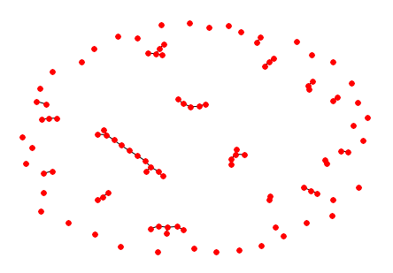
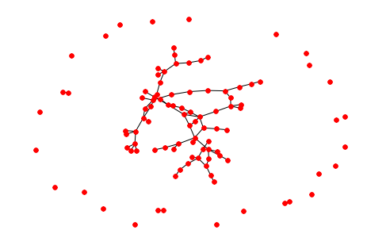
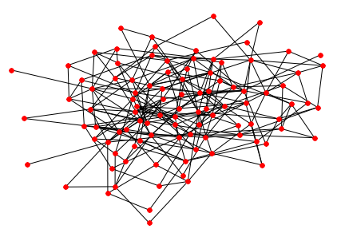
What do ER graphs look like?
$$p<\frac{1}{n}$$
$$p=\frac{1}{n}+ϵ$$
$$p>\frac{log(n)}{n}$$
Very disconnected graph, only tiny connected components
A giant component appears, no/very few cycles
Whole graph is connected, some cycles present

Slide 24
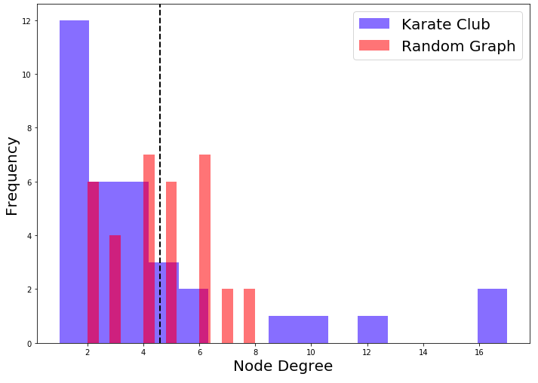

Random Graphs vs Real Networks
Random: node degrees all clustered round the average value
Real: small number of high degree nodes, large number of low degree nodes

Slide 25
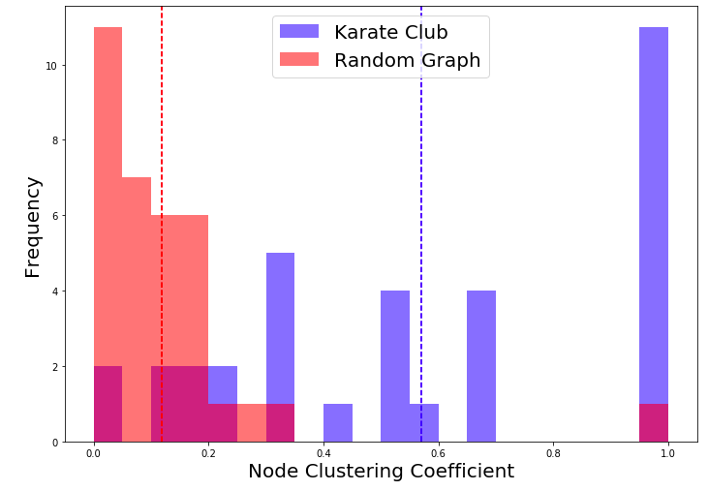
Random Graphs vs Real Networks
Random: very low average clustering coefficent
Real: much higher average clustering coefficient, with some nodes having very high values

Slide 26
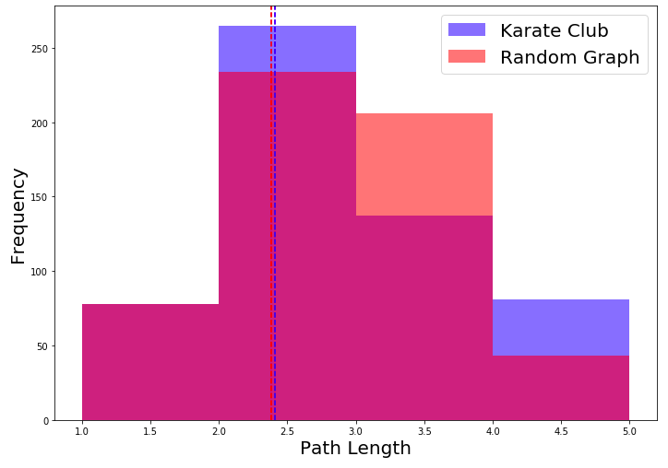
Random Graphs vs Real Networks
Fairly spot on with almost the same average path length for each!

Slide 27
Summary: Random Graphs vs Real Networks
 | Real Social Networks | Random Graphs | ?
Degree Distribution | Heavy Tailed (most nodes have low degree, small few with high degree) | Light tailed (all nodes have close to the average degree) | ?
Clustering Coefficient | High | Low | ?
Path Lengths | Low | Low | ?
? | ? | ? | ?

Slide 28
Real Networks
Thank you for listening! What are your questions?
Random Graphs

